Slide 1

Early phase dose-finding clinical trials in virology
Hakim-Moulay Dehbi, PhD
Head of Statistics, Comprehensive Clinical Trials Unit, University College London, United Kingdom
SCT conference, 16 May 2022

Slide 2

Disclosure
Hakim-Moulay Dehbi: no disclosure / no conflict of interest

Slide 4
Structure of talk
Background
Statistical framework and estimation process
Hypothetical trial
Extension / work-in-progress
Final remarks

Slide 5
Structure of talk
Background
Statistical framework and estimation process
Hypothetical trial
Extension / work-in-progress
Final remarks

Slide 6

Dose-finding studies in virology – two-dimensional challenge
2 dimensions of interest:
  Efficacy: viral load reduction, elimination of virus, induction of latency, lessening of symptoms
  Side effect/toxicity that lead to treatment discontinuation: markedly disturbed kidney / liver function, neuro-psychiatric side-effects, serious rashes, intractable gastrointestinal upset

Slide 7

Dose-finding studies in virology – optimisation problem
Objective: identify the optimum dose (multiple dose levels to investigate and choose from)
Increasing dose => increasing efficacy
Increasing dose => increased chance of side effects leading to treatment discontinuation, which prevent efficacy
There exists a dose level that provides the best compromise between minimising toxicity and maximising efficacy

Slide 8

Anti-viral agents
Failure to provide benefit in two different ways:
Side effects such that the course of the treatment is interrupted, compromising the chance of potentially benefiting from sustained cure
No clinical or virological effect, i.e. no lessening of symptoms, no reduction in viral load, no elimination of virus or induction of latency

Slide 9
Structure of talk
Background
Statistical framework and estimation process
Hypothetical trial
Extension / work-in-progress
Final remarks

Slide 10
Statistical framework (1/4)
m dose levels: d₁, d₂, …, d_{m}
Probability of toxicity increases monotonically with dose
j=1, …, n patients may be entered
X_{j} is random variable for the dose level of j-th patient, taking discrete value x_{j} where x_{j} ε {d₁, …, d_{m}}
Y_{j} is binary (0,1) denoting a toxic response

Slide 11
Statistical framework (2/4)
V_{j} is categorical with k response categories denoting the possible level of efficacy (e.g. low/medium/high viral load reduction)
Conditional probability of efficacy given no toxicity is
Expected value of conditional efficacy distribution is

Slide 12
Statistical framework (3/4)
When Y_{j} = 1 then treatment is incomplete and we assume no efficacy
We then extend the support of the distribution of V_{j} to include 0, where Pr (V_{j}=0 | Y_{j}=1) = 1
Consequently E (V_{j} | x_{j}, Y_{j} = 1) = 0
Unconditional expectation of efficacy at each dose level is

Slide 13
Statistical framework (4/4)
E (V_{j} | x_{j}) lies between 0 and 3
This unconditional expectation of efficacy is referred to as Center of Mass (CM) of the distribution of V_{j}
The goal is to locate the best dose M

Slide 14
Estimation of CM – conjugate Bayesian Dirichlet-Categorical model (1/2)
4 possible response categories k: 0 (tox / no efficacy), 1, 2, 3 (no tox / low/medium/high efficacy)
At dose d_{i} (i = 1, … m), the distribution of V_{j}|P_{i} is categorical С (k, P_{i}), where P_{i} follows a Dirichlet distribution
The Dirichlet distribution D (4, α = (1,1,1,1)) is the prior distribution for P_{i}. The prior mean proportion in each category of V_{j} at dose d_{i} is 25%
Posterior distribution depends on prior and observed data. The vector v_{i} is the number of occurrences in the K categories at d_{i}

Slide 15
Estimation of CM – conjugate Bayesian Dirichlet-Categorical model (2/2)
Sampling from Pi allows the computation of the CM (linear combination of probabilities associated with the 4 response categories)
The prior distribution of the CM is symmetrical and centred at 1.5
Independent MCMC sampling from the posterior distributions of each dose during dose-escalation allows the computation of the probability that each dose is the dose with the largest CM

Slide 16
Structure of talk
Background
Statistical framework and estimation process
Hypothetical trial
Extension / work-in-progress
Final remarks

Slide 17
Hypothetical dose-finding trial
3 dose levels
Dose level 3 with largest CM

Slide 18
Hypothetical dose-finding trial
After first cohort of 6 patients
After 2 cohorts

Slide 19
Hypothetical dose-finding trial
After 3 cohorts
After 4 cohorts

Slide 20
Hypothetical dose-finding trial
After the last cohort (5th cohort) cohorts
52% chance, based on data, that dose level 3 is the one with largest CM

Slide 21
Structure of talk
Background
Statistical framework and estimation process
Hypothetical trial
Extension / work-in-progress
Final remarks

Slide 22
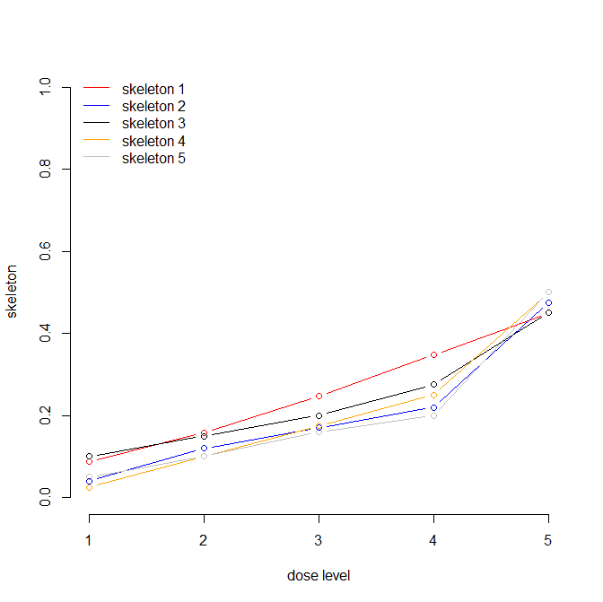
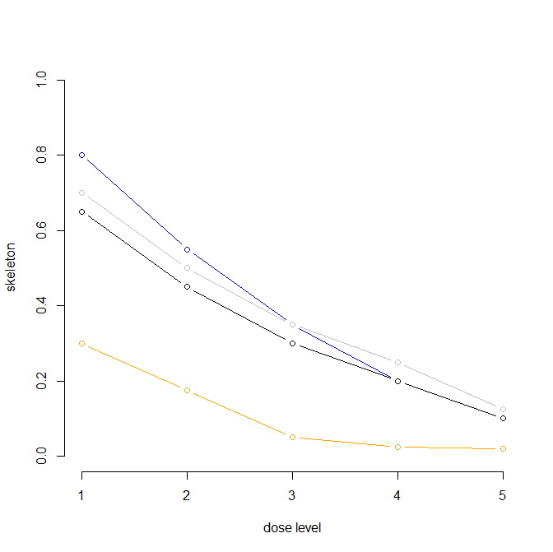
Modelling for both toxicity and efficacy // CRM-inspired approach
Toxicity curve
Low response category curve

Slide 23
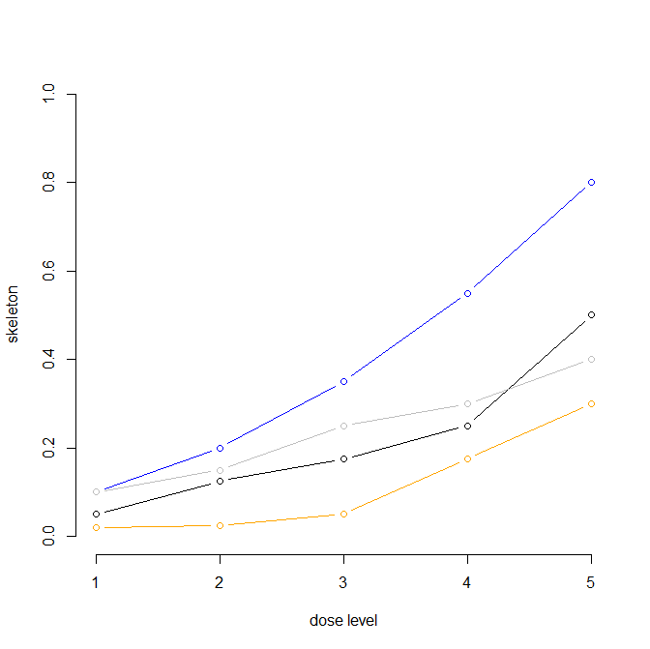
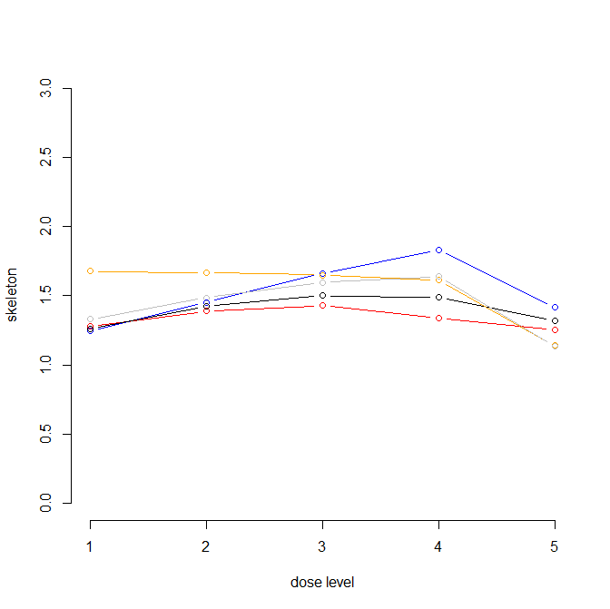
Modelling for both toxicity and efficacy via CRM-inspired approach
High response category curve
Resulting CM curve

Slide 24
Structure of talk
Background
Statistical framework and estimation process
Hypothetical trial
Extension / work-in-progress
Final remarks

Slide 25
Final remarks
Very few methodological publications in dose-finding trials outside of oncology
  There is a need for more methodological research in dose-finding designs outside of oncology and scope to make important contributions
Efficacy is not binary in virology
  Medium levels of efficacy may allow immune-mediate clearance
  Number of response categories (or even using a continuous variable) is an open question
Significant uncertainty remains at end of a dose-finding trial: part 2 of a design could be a randomised selection between the 2 (or 3) most promising doses from the escalation phase

Slide 26


Slide 27
Disclosure
Hakim-Moulay Dehbi: no disclosures / no conflict of interest

